Slide 1
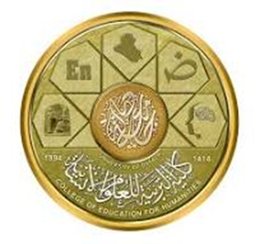
كلية التربية للعلوم الانسانية
قسم اللغة الانكليزية
المرحلة الثانية
شعر القرن السادس عشر
ا.م.د أمجد لطيف جبار

Slide 2
SIXTEENTH CENTURY ENGLISH POETRY
INTRODUCTION

Slide 3
DEFINING THE TERM RENAISSANCE
RENASSANCE is “the most important intellectual revolution in the history of Europe. The word is derived from Latin to mean ‘revival’ or ‘rebirth’ of the classical ‘antiquity’ literature (Greek & Roman). It is dated back to the fall of Constantinople in (1453) when the scholars fled with the manuscripts of the classics. The movement began in Italy, extended to all Europe and lasted for nearly three centuries.”

Slide 4
Naming the Period
Which is more accurate? Why?
1. Elizabethan (1558-1603).
2. Tudor (1536–1553).
3. Jacobean (1567–1625).
4. Renaissance.
5. Early Modern.

Slide 5
Sixteenth Century Contexts
1. Intellectual:
A/ Astronomy of Ptolemy.
B/ Copernicus-1543.
C/ Galileo-1610.

Slide 6
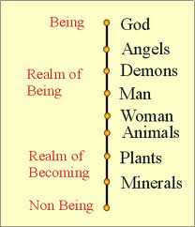
D/ Universal Hierarchy (Great Chain of Being).

Slide 7
E/ Elements & Humors.
Elements: Earth, Air, Water, Fire.
Qualities of Being: Hot, Cold, Moist, Dry.
Each element is to carry TWO qualities.
Humors: Blood, Phlegm, Yellow bile, Black bile.
Each humor is similar to an element, thus bearing Two qualities.
Ben Jonson’s Comedy of Humors.

Slide 8
2. Religious:
A/ The Reformation (Catholic→→Protestant).
Martin Luther & John Calvin (salvation by faith rather than works).
King Henry VIII.
B/ The Act of Supremacy.
Edward VI.
Bloody Mary.
Elizabeth I.
C/ Puritans (removing episcopacy).

Slide 9
3. Political:
A/ Elizabeth I.
Divine Right & Passive Obedience.
Body politic Vs. body natural.
B/ James I.
Unity?
Problems with puritans→rift→civil war in Charles I’s reign.

Slide 10
4. Social:
A/ Aristocrats Vs. all (ancestry, wealth, power).
Social mobility.
Restrictions?
B/ Women:
Masculine society.
Primogeniture.

Slide 11
Spirit of the Age
Humanism: is the spirit of learning that developed at the end of the middle ages with the revival of classical letters and a renewed confidence in the ability of human beings to determine for themselves truth and falsehood. It is a secular movement that is focusing on Man and his relation to every day life.

Slide 12
Themes of Renaissance Literature
1. The Carpe Diem theme.
2. The admiration of beauty.
3. The call for dreams and sleep to escape reality.
4. A call for love (physical).
5. The shortness of life.

Slide 13
Forms of Renaissance Literature
NOTE: Ren. Poetry is majorly written in musical forms relying heavily on Rhyme and Meter.
1. The Sonnet. (Petrarchan, Shakespearean, Miltonic).
2. The Lyric.
3. The Allegory.
4. The Madrigals.
5. The Pastoral.

