Slide 1

المرحلة الرابعة / الشعر الحديث
ا.م.د أمجد لطيف جبار

Slide 2
Major Movements Of Modernist Literature

Slide 3
1. Realism
Realism is a style of art that depicts what the eye can see. It tries to capture every day people doing every day ordinary things.

Slide 4
Features of realism
Verisimilitude of detail derived from observation rather than an idealized view of human nature and experience.
Objectivity in presentation becomes increasingly important: overt authorial comments or intrusions diminish as the century progresses (first-person narrator).
Logic & Reason.

Slide 5
Representative writers
1. William Dean Howells (middle class; man in his natural and unaffected dullness)
2. Mark Twain (lower class)
3. Henry James (upper class)
4. G.B. Shaw
5. Henrik Ibsen

Slide 6
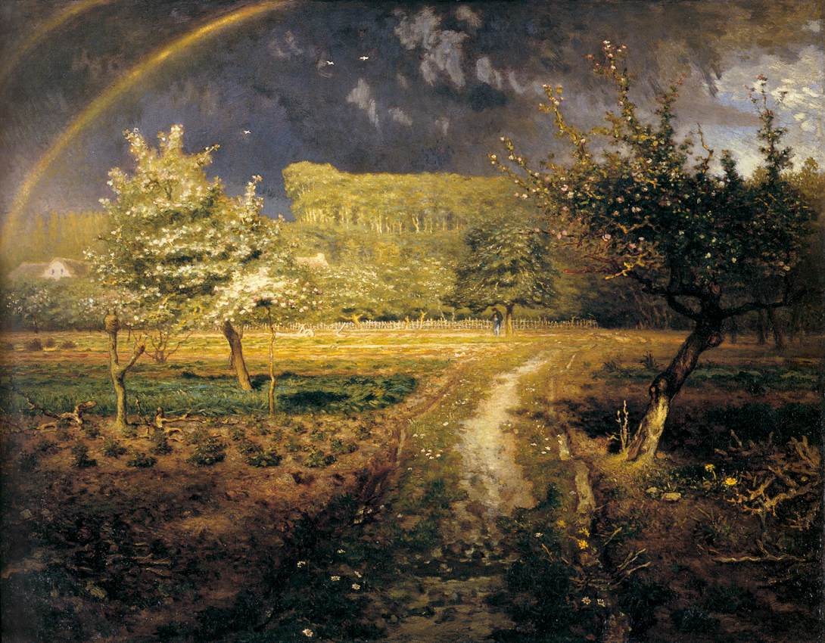
Jean-Francois Millet
“Spring”

Slide 7
2. Naturalism
Naturalism is a movement in literature that developed out of realism.
Naturalism was a literary movement that originated in France in the late 1800’s.
Like the realists, the naturalists sought to render common people and ordinary life accurately. However, the naturalist’s emphasized how instinct and environment affect human behavior.

Slide 8
Strongly influenced by Charles Darwin’s ideas, the naturalists believed that the fate of humans is determined by forces beyond individual control.
Naturalism almost entirely dispensed with the notion of free will, or at least a free will capable of enacting real change in life’s circumstances.

Slide 9
Characteristics
Pessimism- a character tends to repeat a phrase having a negative outlook, which sometimes emphasizes the certainty and quality of death.
Detachment- the author tries to maintain an objective tone and creates a neutral or change by introducing nameless characters.
Determinism- the idea that individual characters have a direct influence on their lives is replaced by a focus on nature.
Fatalism.

Slide 10
Key-Authors
Emile Zola.
Thomas Hardy.
Hart Crane.
“When it occurs to a man that nature does not regard him as important, and that she feels she would not maim the universe by disposing of him, he at first wishes to throw bricks at the temple, and he hates deeply the fact that there are no bricks and no temples.”

Slide 11
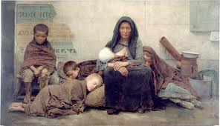

Slide 12
3. Impressionism
The impressionist style of painting is characterized chiefly by concentration on the general impression produced by a scene or object and the use of unmixed primary colors and small strokes to simulate actual reflected light.
Occurred primarily in France between 1867-1886.

Slide 13
Features
1. Not true representation of objects or people portrayed.
2. It is up to the impression of the viewer [e.g. yellow & blue close to each other?].
3. Moments captured quickly rather than accurate detail, quick brush-strokes.

Slide 14
Key-Figures
Edouard Manet
Father of Impressionism – joined the group in 1873, but never stopped using black.
Oscar Wilde.
Joseph Conrad.

Slide 15
"Impression : Sunrise(1872)

Slide 16
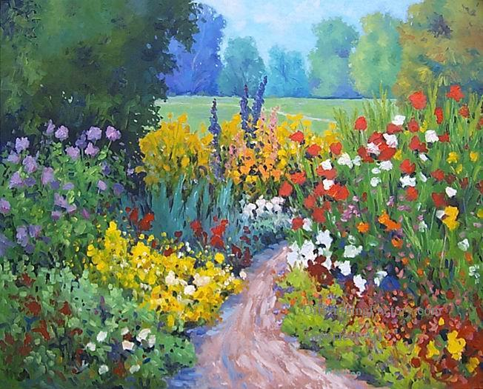

Slide 17
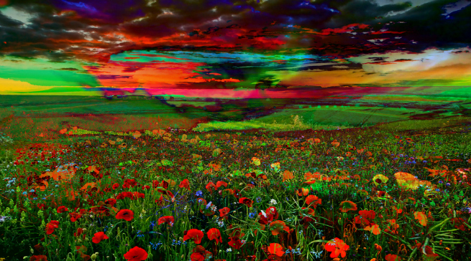

Slide 18
4. Expressionism
Expressionism is a term that was first coined in 1901.
Expressionism in painting emphasizes strong inner feelings about an object.
Portrays life as modified, twisted, and distorted by the artist’s personal perception of reality.
Does not try to imitate reality, but transform it.

Slide 19
Expressionism seeks to discover and examine the essence of life, the internal, eternal meanings of facts, objects, and people.
Expressionism seeks to find a deeper reality than on the surface.
Expressionism is not sight; it is vision

Slide 20
Expressionist Technique
Expressionist Truth was subjective.
New artistic means were needed in order to express these new perspectives and bring audiences beyond the surface:
    Distorted line
    Exaggerated shape
    Mechanical stage movement and body language
    Abnormal coloring of set and lighting

Slide 21
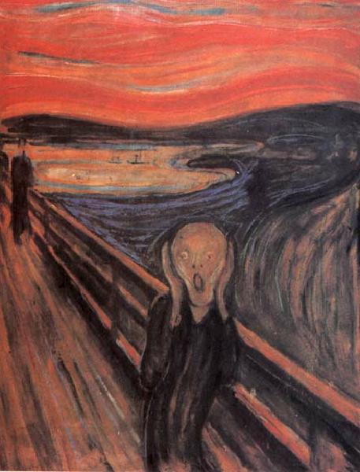

Slide 22
This painting is often interpreted as an EXPRESSION of Munch’s personal torment and mental illness.

Slide 23
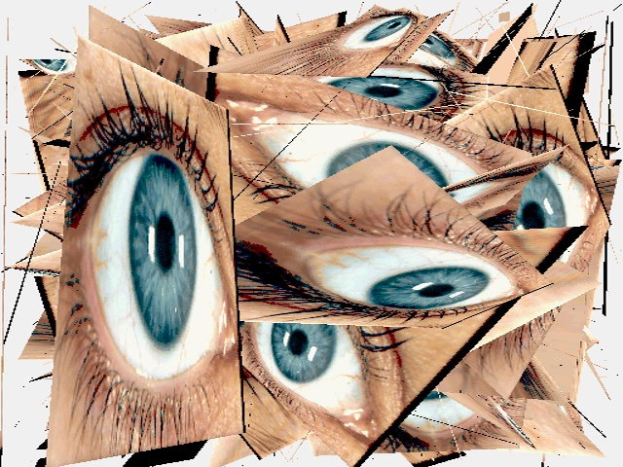

Slide 24
Outstanding Writers
1. Eugene O’Neill……..Drama.
2. Franz Kafka…………..Novel.
3. Paul Boldt…………….Poetry.

Slide 25
5. Surrealism
Surrealism is a style of art and literature developed principally in the 20th century, stressing the subconscious or non-rational significance of imagery arrived at by the exploitation of chance effects
and unexpected juxtapositions.

Slide 26
Traits
1. The true function of thought is in the absence of all control by reason, and outside all aesthetic and moral preoccupations.
2. Importance of dreams, imagination as revealed in dreams.
3. automatic writing, hallucination, word-games.
4. Calligrammatic poetry.

Slide 27
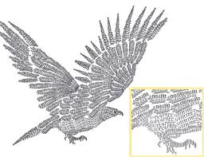
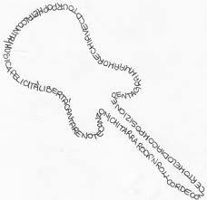
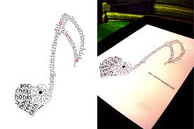

Slide 28
Key-figures
Andre Breton---painting.
Salvador Dali---painting.
Pablo Neruda---poetry.
Antonin Artaud---drama.

Slide 29
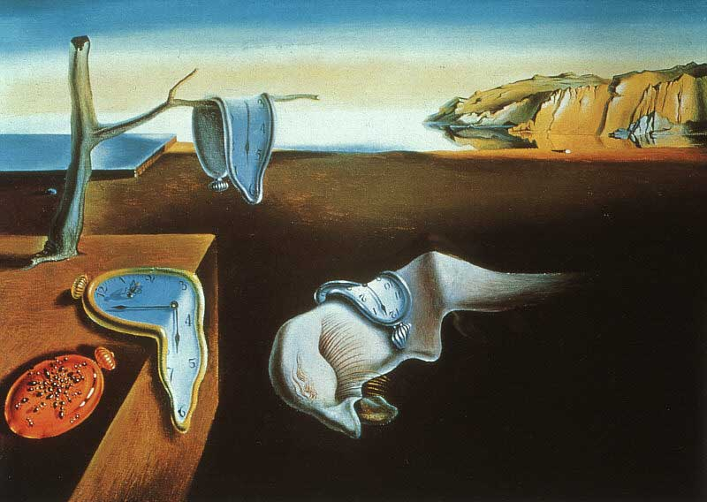
Salvador Dali. The Persistence of Memory. 1931

Slide 30
6. Existentialism
Existentialism emphasizes the uniqueness and isolation of individual in a hostile and indifferent universe.
It stresses freedom of choice and responsibility for the consequences of one’s acts

Slide 31
“Existence Precedes Essence”
This means that Man is:
Identified by his actions.
That He is responsible for his actions.

Slide 32
Jean Paul Sartre says:
“Man first of all exists, encounters himself, surges up in the world and defines himself afterwards.”

Slide 33
An individual’s essence is defined by that individual.
The way the individual creates identity is through the way he/she creates or lives their life.

Slide 34
Astound Writers
Thomas Carlyle.
Ralph Ellison.
Albert Camus.
Jean Paul Sartre.

Slide 35


Slide 36
7. Absurdism
a philosophy based on the belief that the universe is irrational and meaningless and that the search for order brings the individual into conflict with the universe

Slide 37
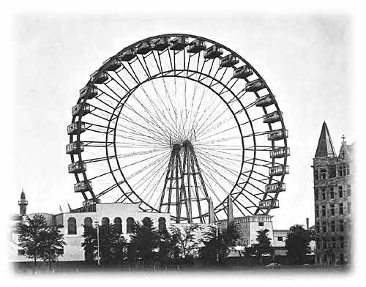
Absurdism is like a Ferris Wheel!

Slide 38
The participants are trapped in a revolving circle that does not let them evolve into a better person.

Slide 39
Martin Esslin defined Theatre of Absurd in 1961 as theatre that:
“Strives to express its sense of the senselessness of the human condition and the inadequacy of the rational approach by the open abandonment of rational devices and discursive [rambling] thought."

Slide 40
Absurdist Themes
People wanted to find meaning within life, since the war had ended.
With all of the horrors they had seen, the Absurdist writing became relentless and bitter.

Slide 41
Theatre of the Absurd Elements:
Departs from realistic characters and situations.
Plots are often meaningless. (non-linear)
Time, place and identity are unclear or confusing.
There is confusing and repetitive language.

Slide 42
There are only five designated Theatre of the Absurd Playwrights:
Samuel Beckett of Ireland, the most well-known.
Eugene Ionesco of Romania.
Jean Genet of France.
Arthur Adamov of Russia.
Harold Pinter of England.

Slide 43
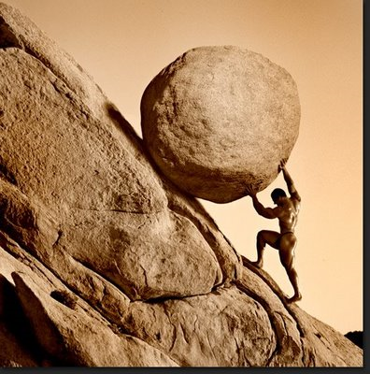

Slide 44
8. Symbolism
Symbolism is a form of expression in which the world of appearances is violently rearranged by artists who seek a different and more truthful version of reality.
Symbolist poets did not merely describe objects; they tried to portray the emotional effects that objects can suggest.

Slide 45
They sought to get rid of the typical “symbols” and explore more imaginative choices.
They focused more on how to keep individualism in a modern world that was succumbing to the power of mass culture.

Slide 46
Outstanding Poets
1. W.B. Yeats.
2. Charles Baudelaire.
3. Arthur Rimbaud.

Slide 47
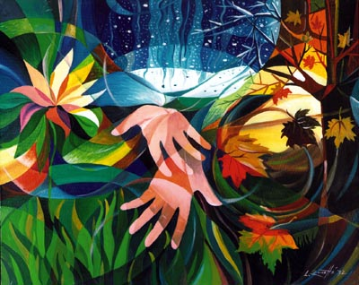

Slide 48
9. Imagism
Imagism tends to seek clarity of expression through the use of precise visual images.
Imagists tried “to use absolutely no word that does not contribute to the presentation” and “to compose in sequence of the musical phrase, not in sequence of the metronome”

Slide 49
Imagists believed poetry could be made purer by concentration on the precise, clear, unqualified image.
Imagery alone, they believed could carry a poem’s emotion and message.
The Imagists sought to rid poetry of its prettiness, sentimentality, and artificiality.

Slide 50
Major Poets
1. H.D.
2. Ezra Pound.
3. William Carlos Williams.
4. Amy Lowell.
5. D.H Lawrence.

Slide 51
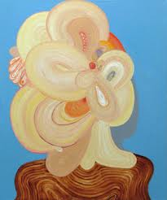

Slide 52
“In a Station of the Metro”
Ezra Pound
The apparition of these faces in the crowd;
Petals on a wet, black bough.

Slide 53
Realism Vs. Modernism
Modernism | Realism
Argued for cultural relativism | 1. Emphasized Absolutism
2. Believed that people form their own meaning in the world | 2. Believed that a single reality could be determined through observation of nature

Slide 54
Premodern Vs. Modern
Modern | Premodern
1. chaotic | 1. Ordered
2. Futile | 2. meaningful
3. Pessimistic | 3. optimistic
4. Fluctuating | 4. stable
5. Loss of faith | 5. faith
6. Collapse | 6. morality/ values
7. Confused sense of identity and place in the world. | 7. Clear sense of identity

Slide 55
The Main Characteristics of Modernist Poetry
Modern poetry is free from traditional restrictions of rhyme and rhythm.
It is greatly affected by modern science and technology.
The modern poet is pessimistic about the future of modern man and his world.
Modern poetry is affected by modern political , social and economic theories.

Slide 56
In modern poetry, words are used more symbolically than literally.
The language of modern poetry is that of everyday conversation. (The modern poet is speaking to his reader in an intimate tone of voice).
In modern poetry, man is represented as a lonely exile who is seeking his home.

Slide 57
There is no logical argument in a modern poem. Rather, the poem depends on the free association of ideas. The modern poem is “a heap of broken images”.

