Slide 1

كلية التربية للعلوم الانسانية / قسم اللغة الانكليزية
المرحلة الثانية / القصة القصيرة
ا.م.د أمجد لطيف جبار

Slide 2
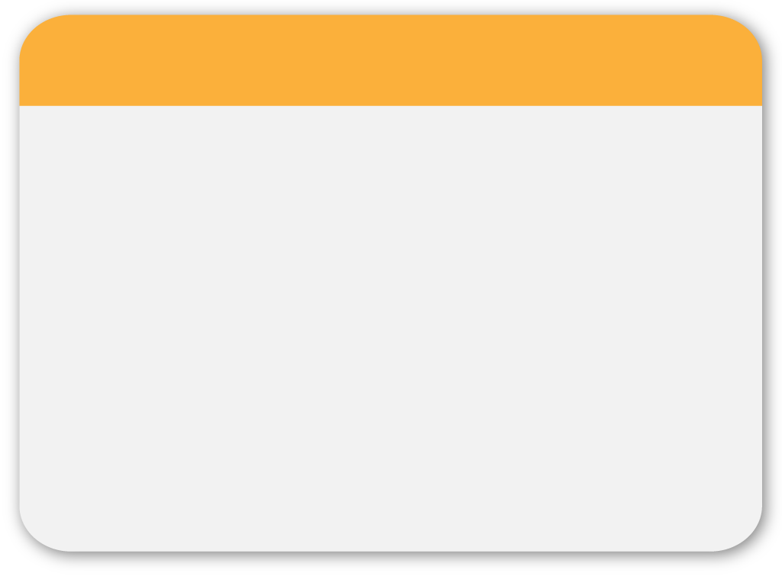


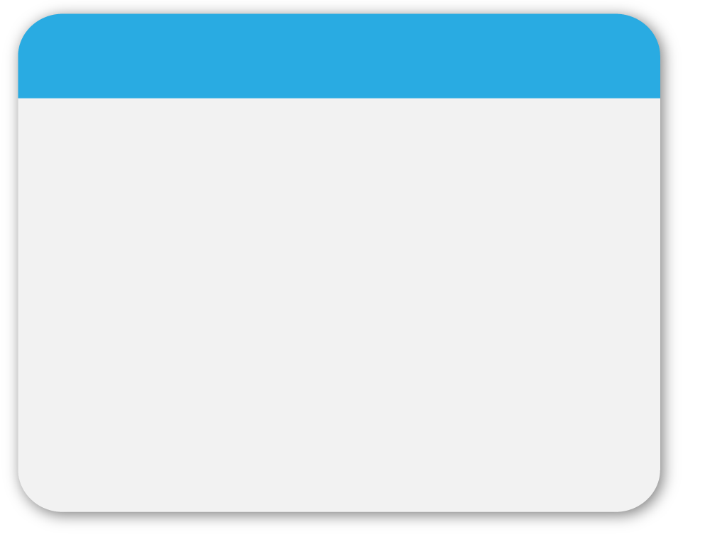

01
WINTER
Oscar Wilde’s “The Happy Prince”
Template

Slide 3
02
WINTER
Biographical Notes:
Educated, literary, Irish family.
Brought up like a girl.
Imprisoned?
Bad in mathematics, hates bombastic language.
Template

Slide 4
03
WINTER
Plot Analysis:
1. Exposition: At the beginning of this story, the author directly described the Happy Prince's appearance and then used the citizens' words to emphasize the "happy" image of the Happy Prince. However, after reading the whole story, we can notice that the name of the Happy Prince is ironic, since he wasn't happy at all. The Swallow falls in love with Reed, so he didn’t go to Egypt with the other swallows. After other swallows had gone, he felt lonely and tired of his lover, the Reed. The swallow thinks the Reed is a coquettish girl, so he decided to leave her.
Template

Slide 5
04
WINTER
2. Rising Action:
The Swallow arrived at the city and alighted between the feet of the Happy Prince. A drop fell on the Swallow, and he found out that the drop was the Prince’s tear. The Happy Prince demanded the Swallow to be his messenger, helping him to bring the jewels to someone in need; however, the Swallow agreed reluctantly.
Template

Slide 6
05
WINTER
3. Climax: The Happy Prince became blind, so the Swallow decided to stay with him and replaced his empty eyes, to watch the city and tell the Happy Prince what he sees. The Happy Prince then requested the Swallow to take off the fine gold covering him and sent the gold to the poor.
Template

Slide 7
06
WINTER
4. Falling Action: The Swallow soon realized he would die because of the cold winter. He determined not to leave the Prince, because he loved him so much. The Prince asked the Swallow to kiss his lips, and the Swallow did so then fell down at the Prince's feet. At that moment, a crack sounded inside the statue as the Prince's heart broke. The statue was then pulled down and put into a furnace as it was no longer deemed “beautiful”.
Template

Slide 8
07
WINTER
5. Resolution: God asked his angels to find “the two most precious things in the city." The Happy Prince’s broken heart would not melt and was brought up to heaven along with the dead swallow.
Conflict:
-Human vs. Human (prince vs mayor)
-human vs. Society (material society)
-human vs. nature (swallow vs winter)
Template

Slide 9
08
WINTER
Major Characters:
1. The Happy Prince (protagonist)
Golden statue that can see what is going on around him but
cannot move. He was a happy prince, but he weeps for all the
hardships that are faced by the people of this city. He asks the
swallow to take pieces of him (the gold leaf of the statue the
sapphires that are his eyes, and the ruby that is the hilt of his
sword) and give them to the poor of the city. In the end, he
is melted and the statue is not beautiful without its
decorations
Template

Slide 10
09
WINTER
2. The Swallow (protagonist)
A bird stayed behind when the rest of his block migrated to Egypt in order to court river plant that he had fallen in love with. His friends disapproved and thought that this was a foolish decision. The reed eventually decides that she will not accompany him. The swallow is infuriated and he decides to migrate to Egypt by himself at all. However before he leaves, he tries to sleep one night under the statue of the happy prince the statue begins crying because he is saddened by everything that he sees going on in the city, the swallow is the agent of the happy prince’s generosity, bringing the germs and gold to the poor as instructed, and the two become fast friends. Eventually, the swallow dies because he chooses to remain with blind prince rather than abandon fly to Egypt, and the winter gets too cold. He dies at the feet of statue.
Template

Slide 11
10
WINTER
MINOR CHARACTERS
1. The Reed (minor-flat): she decides not to accompany the swallow, who has been courting her, breaking his heart. She is too close to her home and cannot bear the thought of leaving thus the swallows courtship was in vain.
2. The Town Councilors
They are greedy and obsessed with their public images, they
cannot understand the humanity of dead prince and of a little
bird but they are too busy in their daily pursuits to increase
their money, rank and power.
Template

Slide 12
11
WINTER
3. The Poor Woman
Her son is ill. She struggles as a seamstress to make enough
money to take care of him. She receives that ruby from the hilt
of the prince’s sword.
4. The Young Playwright
He is starving and struggling to complete a play but he is
unable to concentrate because his he is so hungry. He
receives the first sapphire eye.
Template

Slide 13
12
WINTER
5. Little Match Girl
She drops the matches that she is supposed to sell, and is crying because she knows that she will be beaten by her father when she will return to home without the matches or any money. She receives the second sapphire eye.
Template

Slide 14
13
WINTER
6. The Mayor (stereotype-antagonist)
He orders that the statue must be turned down. He wants the metal to be made into the statue of himself.
Template

Slide 15
14
WINTER
Setting: The setting of "The Happy Prince" keeps the reader's mind active and vivid. First of all, the characters are presented in a city. As a result, we can see in this city the widening gap between the rich and the poor. Also, the statue should be in a city where it is placed in a square, so the Happy Prince can see the ugliness of his city. Moreover, the story takes place during winter when people become in bad need of help. This gives the Happy Prince the chance to see the bad side of his city and give the reason for the Swallow's death.
Template

Slide 16
15
WINTER
Narration: third person omniscient
Template

Slide 17
16
WINTER
Devices:
Personification:
the writer personified the statue of the happy prince and swallow, as living human beings, mayor and councilors symbolize the hypocrisy of Victorian age. They talk with each other like human because they feed the misery of living Creatures which human being is ignoring
Template

Slide 18
17
WINTER
2. Simile
“His hands are like withered leaves‟.
“Lips are red as pomegranate‟.
“As blue as the great sea‟.
“Who is as black as ebony‟.
“They have eyes like green beryl‟
Wilde has set different visions or visual imagery as: „the
streets looked as if they were made of silver, they were so
bright, and glistering long icicles like crystal daggers………,
Template

Slide 19
18
WINTER
3. Irony
Oscar Wilde has used the term irony in this story. He has shown the contrast between rich and poor people “Swallow flew over the city, and saw the rich taking merry in their beautiful houses while the beggars were sitting at the gates”. These lines show that rich people do not care about the poor people. They were enjoying their site. They are living in their palace and do not know about the conditions of poor people “what is the use of a state if it cannot keep the rain off?
Template

Slide 20
19
WINTER
4. Satire
Oscar wild used the literary term satire in this story. Satire on
educational system and satire on social injustices in “the
happy prince” Wilde mentions a professor who was surprised
by seeing a swallow in winter and he wrote a long letter
about it to the local newspaper. Everyone quoted it that it was
full of so many words that they could not understand”.
Though this fairy tale was written on the demand of his son
yet it is full of satiric characters, situations and issues
Template

Slide 21
20
WINTER
5. Allegory: a story of two meanings; one is explicit, the second is implicit.
Template

Slide 22
21
WINTER
Themes:
Sacrifice and charity
Social injustice
Appearance vs. reality
True friendship
Materialism.
Template

