Slide 1
Anticoagulants,
plasma&serum

Slide 2
Anticoagulants: are agents used in order to obtain blood sample free from clot, which used in blood transfusion and blood analysis.

Slide 3
1.heparin: anticoagulant present in the body naturally, Synthesized by the basophilic white blood cell. It function inhibit the clotting factor (stuart X).

Slide 4
2.EDTA (ethylene diamine tetra acetic acid) : this agent chalet calcium to prevent formation of clot.

Slide 5
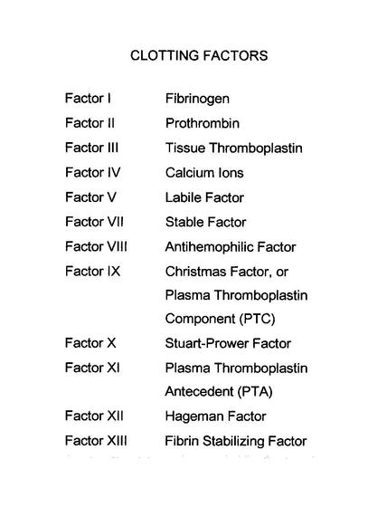

Slide 6
plasma=blood+anticoagulants
sreum=blood without anticoagulants

Slide 9
Clotting time:
Capillary tube method
Material and instrument:
1.capillary tube (non hepranized)
2.lancet

Slide 10
Procedure:
1.prick the finger and load a capillary tube (non hepranized) to at least ½ full.
2.after about 1-5 minute take capillary tube between thumb and forefinger and gently break in half. Slowly pull the ends apart to view the insoluble fibrin strand.
Usually we do a break every 30 second. Once the clot is formed we record the time.

Slide 11
Medical application:
Prolong of clotting time may be due to :
1.decrease in factor VIII (hemophilia).
2.decrease in factor IX (Christmas disease)
3.liver failure
4.vitamine K deficiency

Slide 12
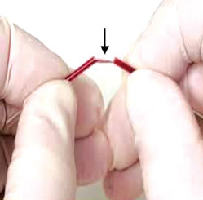

Slide 13
Bleeding time: is a measure of time needed for the spasm of capillaries to occur and platelet plug formation.
Normal range for bleeding time 2-6 minutes.
Bleeding time measure by Duk method.

Slide 14
Duke method: Using a circular filter paper the blood is blotted every 15-30 sec, without allowing filter paper to touch the wound.
The moment that the bleeding ceased this will represent the bleeding time.

Slide 15
Method
We can measure bleeding time by Duke method
Material and instrument
1.lancet
2.circular filter paper.

Slide 16
Procedure:
1.puncture the finger tip by lancet.
2.the recording of time is started at the time of puncture.
3.using the circular filter paper the blood is blotted every 30 second without allowing the filter paper to touch the wound.
4.the moment that the bleeding ceases and this will represent the bleeding time.

Slide 17
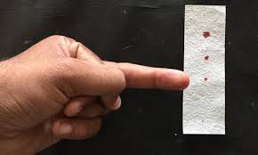

Slide 18
Medical application:
The prolong of bleeding time is due to:
1.decrease number of platelets (thrombocytopenia)
2.defect in function of platelets ( as in case of aspirin used).
3.defect in vessels themselves.

