Slide 1
جامعة ديالى كلية التربية للعلوم الانسانية \ قسم اللغة الانكليزية م.د. زينب سعد محمد المرحلة الاولى المادة التلفظ

Slide 3
Far /fɑː/ car /kɑː/ star /stɑː/ bar /bɑː/ jar /dʒɑː/ cigar /sɪɡɑː/ radar/reɪdɑː/ repertoire /rep.ə.twɑː/ tar/tɑː/ spar /spɑː/
Examples
after /’ɑːftə/
last /lɑːst/
ask /ɑːsk/
start /stɑːt/
part /pɑːt/
large /lɑːdʒ/
party /ˈpɑːti/
art /ɑːt/
arm /ɑːm/
answer /ˈɑːnsə/
argue /ˈɑːgjuː/
father /ˈfɑːðə/
market /ˈmɑːkɪt/
class /klɑːs/
laugh/laːf/
Heart/hɑːt/
Card /kɑːd/
market /ˈmɑːkɪt/
class /klɑːs/
hard /hɑːd/
Harbour /hɑːbər/
marvel/mɑːvəl/

Slide 4
/uː/ back, close, rounded, long vowel.
/ʊ/back, half close, rounded, short vowel.

Slide 5
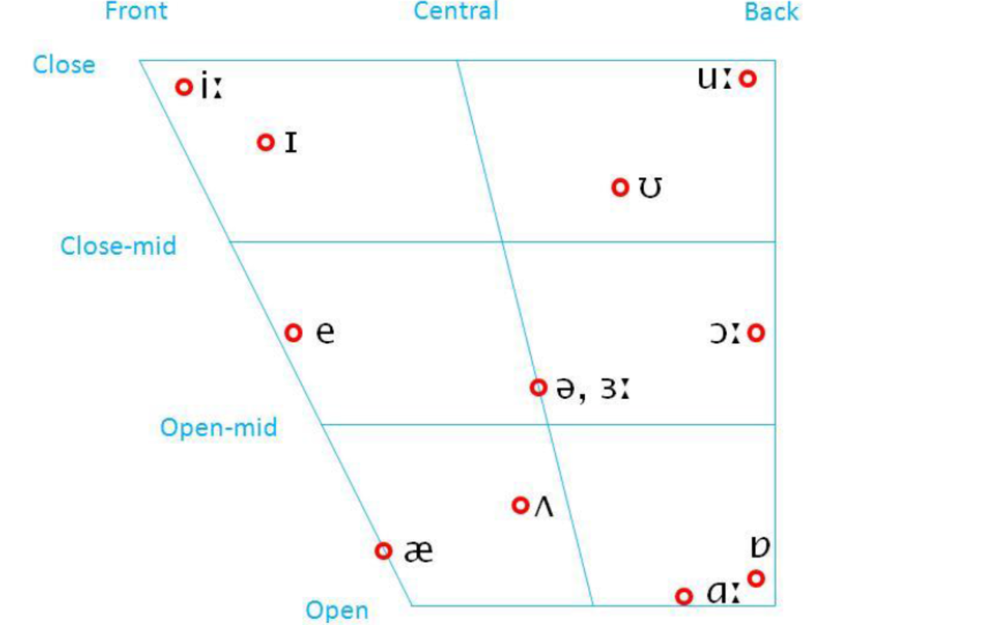

Slide 6
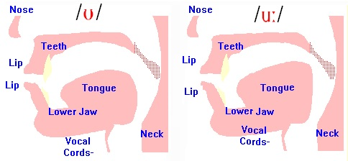

Slide 7
Examples
boot /buːt/
Choose /tʃuːz/
Group /ɡruːp/
Tomb /tuːm/
Move /muːv/
Lose /luːz/
School /skuːl/
Stool /stu:l/
Tool /tu:l/
you /juː/ too /tuː/ to /tuː/ Shoe /ʃuː/ blue bluː/ Crew /kruː/ Through /θruː/ screw /skruː/
Chew /tʃuː/ who /hu:/
Oodles /ˈuː.dəlz/
Ooze /u:z/

Slide 8
Examples
Book /bʊk/
Foot /fʊt/
Bull /bʊl/
bush /bʊʃ/
Bullet /bʊlɪt/
Full /fʊl/
Bosom /bʊzəm/
Butcher /bʊtʃə/
Good /ɡʊd/

Slide 9
/ɒ/ back, open, rounded, short vowel.
/ɔ:/back, between half close and half open, rounded, long vowel.

Slide 10
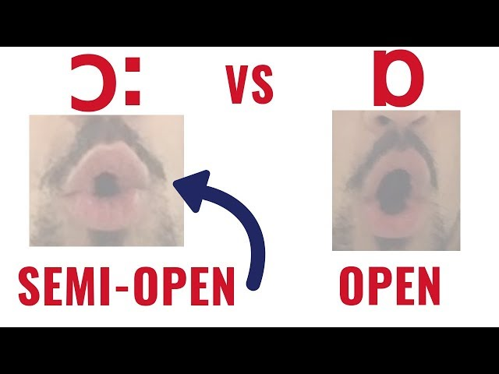

Slide 11
Examples
from /frɒm/
problem /ˈprɒbləm/
because /bɪkɒz/
restaurant /res.tər.ɒnt/
what /wɒt/
watch /wɒtʃ/
on /ɒn/
Octopus /ɒktəpəs/
Ostrich /ɒstrɪtʃ/
Obvious /ɒbvi.əs/
Obviate /ɒbvieɪt/
Occupy /ɒkjəpaɪ/
Object /ɒbdʒɪkt/
Obligation /ɒblɪɡeɪʃən/

Slide 12
Examples
Cord /kɔːd/
Nought /nɔːt/
dawn /dɔːn/
Shorn /ʃɔːn/
Sort /sɔːt/
Bought /bɔːt/
Chalk /tʃɔːk/
Roar /rɔː/
Saw /sɔː/
door /dɔː/
sure /ʆɔː/
war /wɔː/
Floor /flɔː/
Four /fɔː/
Raw /rɔː/
Awsome /ɔːsəm/
Order /ɔːdə/
Organize /ɔːɡənaɪz/
Orphan /ɔːfən/
Awkward /ɔːkwəd/
Also /ɔːlsəʊ/
Although /ɔːlðəʊ/
All /ɔːl/
Already /ɔːlredi/

Slide 13
Examples
- Neil Armstrong

