Slide 1
جامعة ديالى كلية التربية للعلوم الانسانية \ قسم اللغة الانكليزية م.د. زينب سعد محمد المرحلة الاولى المادة التلفظ

Slide 2
Mirjam Nilsson​

Slide 3
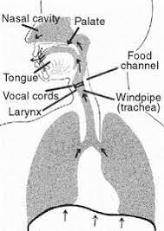
*Sounds are produced with air coming from the lungs.. * we interfere with the air passage in various ways and at various places. * Articulatory Phonetics studies the organs of speech (speech articulators).

Slide 4
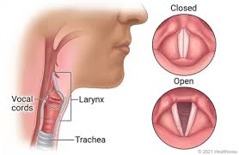
Vocal cords
Vocal cords lie in the larynx.
When the airstream coming from the lung through the trachea reached to the larynx, the vocal cords can either allow it to pass freely or compressed it under beneath.
* The vocal cords can occur in one of the following states:

Slide 5
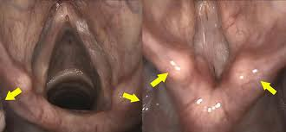
Enhancing your presentation

Slide 6
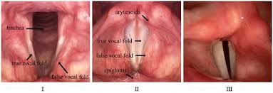
They can move towards each other to cover the top of the wind pipe, so that no air will pass through.
They can be drawn apart, so that the air will pass freely. Voiceless sounds are produced as a result.
When they are opened suddenly, the compressed air bursts out and it makes the vocal cords vibrate. This process results in voiced sounds.
* The glottis
* Glottal stop
* Voice
* Pharynx

Slide 7
The palate
Bony area
Hard except for the soft palate.
Divided into three parts.
Alveolar ridge / Hard palate / soft palate (uvula) /juːvjələ/

Slide 8
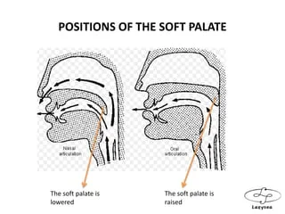

Slide 9
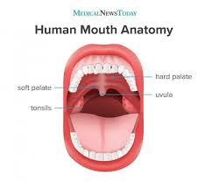

Slide 11
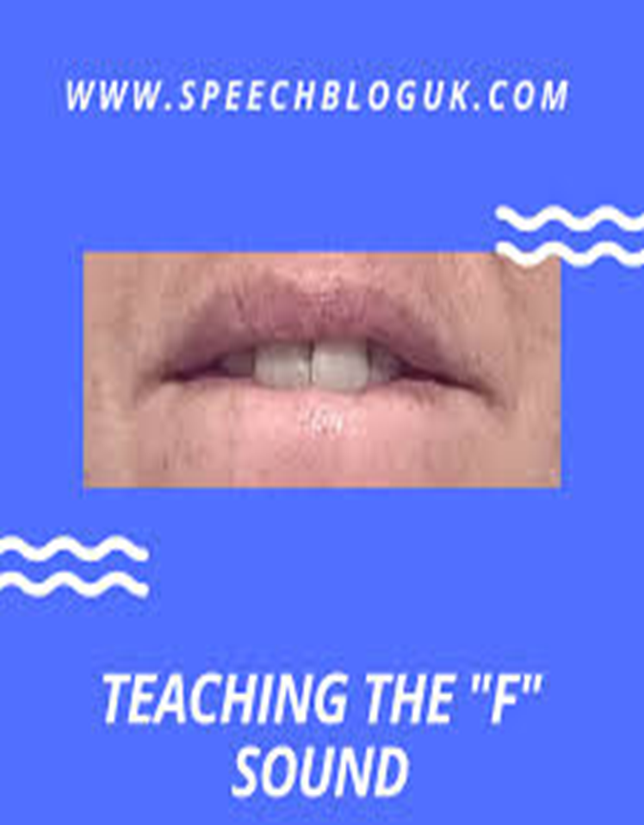

Slide 13
Movable (Active) and Unmovable (Passive) Organs (Articulators) of Speech
Active articulators: those articulators that can move when producing a sound.
The lower lip
the tongue
vocal cords
Passive articulators: those articulators which do not move when producing a sound.
The upper lip
The upper teeth
The hard palate
The soft palate
Uvula
The roof of the mouth (Palate)
pharynx wall

Slide 14
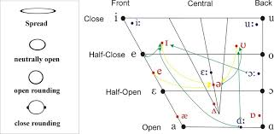

Slide 15
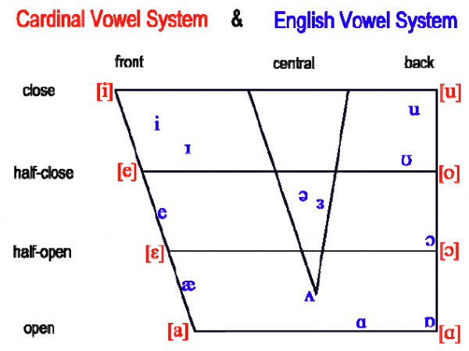
Vowel sound /ɪ/half close, front, unrounded, short vowel.

Slide 16
Itch /ɪtʃ/
Image /ˈɪm.ɪdʒ/
Imitate /ɪmɪteɪt/
ill /ɪl/
Invent /ɪnvent/
In /ɪn/
Elect /ɪlekt/
Elide /ɪlaɪd/
Intimate /ɪntɪmət/
his /hɪz/
Thing /θɪŋ/
Give /ɡɪv/
Little /lɪtəl/
Kill /kɪl/
Still /stɪl/
Wizard /wɪzəd/
Wicked /wɪkɪd/
Chili /tʃɪli/
Pretty /prɪti/

Slide 17
Thank you
Mirjam Nilsson​
mirjam@contoso.com
www.contoso.com

