Slide 1
جامعة ديالى/ كلية التربية للعلوم الانسانية مادة القراءة والكتابة/ المرحلة الاولى تدريسية المادة: ا.م. د.ايمان رياض اديب

Slide 2
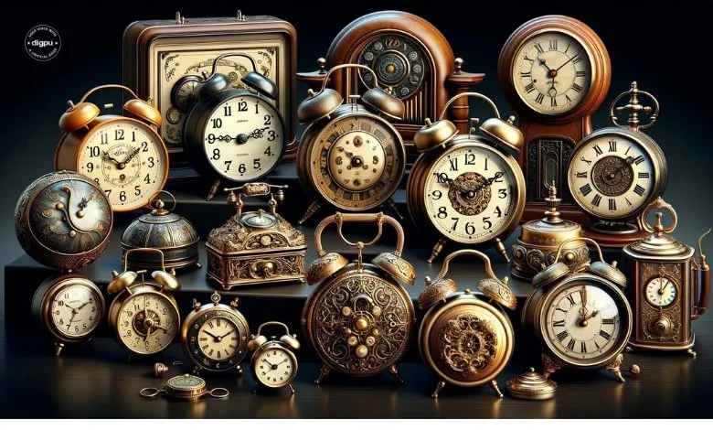
Reading and Writing: Unit Two TIME

Slide 3
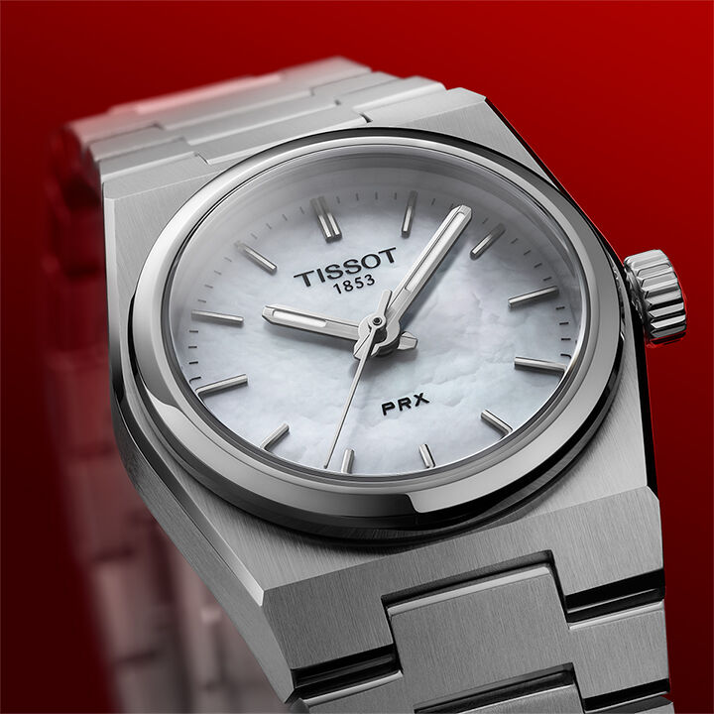

Slide 4
Discussion Questions
1. Look at the picture. What can you see? What is it?
- In the picture, I can see ... I think it's a ...
2. Do you wear a watch? How often do you check the time?
- I always/sometimes/never wear a watch because ...
- I check the time ...
3. Are you ever late for class? Why or why not?
- I am always/sometimes/never late for class because ...

Slide 5
Your opinions
1. In the picture, I can see a watch.
"I wear a watch to help me stay on schedule and be on time for appointments.“
2. I always wear a watch because it helps me stay on schedule and manage my time effectively.
I check the time frequently throughout the day, especially before meetings or appointments.
3. I am never late for class because I make sure to plan my time carefully and leave home early.
I am sometimes late for class because unexpected delays, like traffic, can disrupt my schedule.
I am always late for class because I struggle with time management in the mornings.

Slide 6
Reading skills- Vocabulary preview
1. Accurate means :
Precise
Correct
Exact
True
Faultless
2. Punctual
On time
Prompt
Timely ( adjective means at the right time , she gave a timely reminder about the deadline… adverb as promptly …I submitted my report
Regular
Dependable

Slide 7
Prioritize
Rank
Organize
Arrange
Sequence
Emphasize
Schedule
Plan
Program
Organize
Arrange
Timetable
Skip
Omit
Avoid
Overlook
Pass over
Bypass

Slide 8
What is a BLOG?
A blog is a type of online platform or website where individuals, groups, or organizations share content regularly in the form of posts. Blogs often focus on a particular topic or theme and can include text, images, videos, and links to other resources.
Answer the questions:
Do you ever read blogs? Why or why not? If so, which of the types in the box on the right do you read? What can people learn from blogs? Discuss with a partner.
I often/sometimes/never read blogs because they provide interesting information and insights.
I think people can learn new skills, ideas, or perspectives from blogs.
For example, I read travel/sports/cooking blogs to learn about places to visit, recipes, or sports updates.

Slide 9
Blogs Vs. Vlogs
Aspect | Blog | Vlog
Format | Written content (with images). | Video content.
Platform | Websites or blogging platforms (e.g., WordPress). | Video-sharing platforms (e.g., YouTube).
Engagement | Text-based interaction. | Visual and auditory interaction.

Slide 10
IDENTIFYING THE AUTHOR'S PURPOSE
Every author has a purpose or reason in writing a text. Identifying the purpose will help you to understand the text. Purposes include: to entertain, to persuade, and to inform. Authors may have more than one purpose.

Slide 11
1. To entertain: The author aims to amuse or provide enjoyment to the reader, just like telling stories.
Example: "Once upon a time, a brave little mouse saved a lion from a hunter’s trap, and they became best friends.”
2- To persuade: The author wants to convince the reader to agree with an idea or take a specific action. Example: An advertisement, a political speech, or an opinion article.
-Example: "You should eat more fruits and vegetables because they make you strong and healthy. Start today!"

Slide 12
3- To inform: The author provides facts, instructions, or information to increase the reader’s knowledge. A news report, an encyclopedia entry, or a scientific article.
Example: The sun is a star that provides light and heat to the Earth."

Slide 13
Vocabulary skills: Parts of Speech
Noun – Names a person, place, thing, or idea. Example: dog, city, love.
Pronoun – Replaces a noun. Example: he, she, it.
Verb – Describes an action or state. Example: run, is, seem.
Adjective – Describes a noun or pronoun. Example: tall, happy, blue.
Adverb – Modifies a verb, adjective, or another adverb. Example: quickly, very, outside.
Preposition – Shows the relationship between a noun and another word. Example: in, on, under.
Conjunction – Connects words, phrases, or clauses. Example: and, but, because.
Interjection – Expresses strong emotion. Example: Wow!, Ouch!, Hey!

Slide 14
Describing how to achieve a goal in Writing Task
We are going to learn about:
writing basic sentence patterns, and ,
verbs that can be followed by infinitives and gerunds. then we are going to use these to write a paragraph describing how to achieve goals we set for ourselves.

Slide 15
1. Understanding Sentence Patterns

Slide 16
Basic Components of a Sentence Pattern
1. Subject (S): The person, place, or thing that does the action.
Examples: I, he, she, the cat.
2. Verb (V): The action or state of being.
Examples: write, run, is, has.
3. Direct Object (DO): The thing or person that receives the action.
Examples: a book, advice, a ball.
4. Indirect Object (IO): The person or thing that benefits from the action.
Examples: me, him, her.

Slide 17
Common Sentence Patterns
Subject + Verb (S + V)
Example: I write.
Explanation: The subject (I) performs the action (write).
Subject + Verb + Direct Object (S + V + DO)
Example 1: He has a problem.
Example 2: She loves chocolate.
Explanation: The subject (He, She) performs the action (has, loves), and the direct object (problem, chocolate) receives the action.
Subject + Verb + Indirect Object + Direct Object (S + V + IO + DO)
Example 1: She gave him some advice.
Example 2: He sent me an email.
Explanation: The subject (She, He) performs the action (gave, sent). The indirect object (him, me) is the person receiving the action, and the direct object (advice, email) is the thing being given or sent.

Slide 18
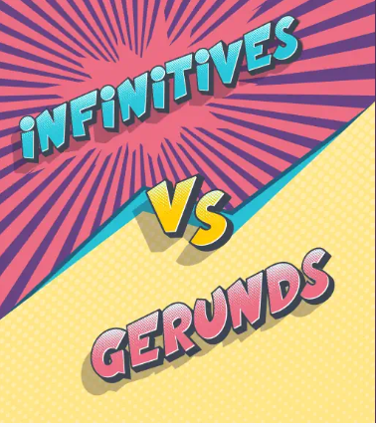
-Gerunds Vs. Infinitives

Slide 19
Grammar
1- Gerund
A gerund is the -ing form of a verb that functions as a noun in a sentence. It can be used as a subject, object, or complement.
Example: Swimming is fun.
In this example, swimming (verb + -ing) acts as the subject of the sentence.
2- Infinitive
An infinitive is the base form of a verb, often preceded by "to", that functions as a noun, adjective, or adverb in a sentence.
Example: She wants to learn.
In this example, to learn (to + base verb) acts as the object of the verb wants.
To be happy is a state of mind. (subject)

Slide 20
Form | Usage | Example Sentence
Infinitive (to + base verb) | As a subject | To learn new things is exciting.
 | As a noun (object) | She loves to swim.
 | After adjectives | It is important to study.
 | To show purpose (adverb) | He left to find help.
Gerund (verb + -ing) | As a subject | Swimming is a great workout.
 | As a noun (object) | I enjoy reading books.
 | After prepositions | She is good at writing.
 | After certain verbs | He avoids eating fast food.

Slide 21
Common Verbs Followed by Infinitives and Gerund
want to: She wants to travel.
decide to: He decided to leave.
hope to: They hope to win.
______________________
enjoy: I enjoy painting.
avoid: He avoids speaking in public.
consider: She considered moving abroad.

Slide 22
Verbs That Can Use Both (with Different Meanings)
Verb | Gerund Meaning | Infinitive Meaning
stop | She stopped smoking. (She quit the habit.) | She stopped to smoke. (She paused to have a cigarette.)
remember | I remember meeting him. (A past memory) | Remember to call him. (A future action)

Slide 23
Note
Infinitives and gerunds can be used interchangeably as the object of some verbs, such as start, begin, continue, love, like,
prefer, hate.
Infinitive after verbs expressing desire or intention (e.g., want, would like).Gerund after verbs describing actions or processes that are ongoing or habitual (e.g., like when referring to the action itself).

Slide 24
What Time Is it?

Slide 25
Reading Text: what time is it?
The passage traces the evolution of timekeeping methods throughout history. In ancient times, people used natural elements to measure time. About 5,500 years ago, the Egyptians invented the sun clock, a large stone structure that used shadows to indicate time, particularly midday. Around 3,500 years ago, they developed the sundial, a smaller device that could measure time for half a day. However, these methods were ineffective during cloudy weather or at night.

Slide 26
Egyptian Clock: Sun Clock

Slide 27
Sundial Clock

Slide 28
Next, the Egyptians invented the water clock around 3,400 years ago. This clock worked by measuring the flow of water from one container to another, which would move a lever to indicate time. Though popular in the Middle East and China, water clocks were not always accurate.

Slide 29
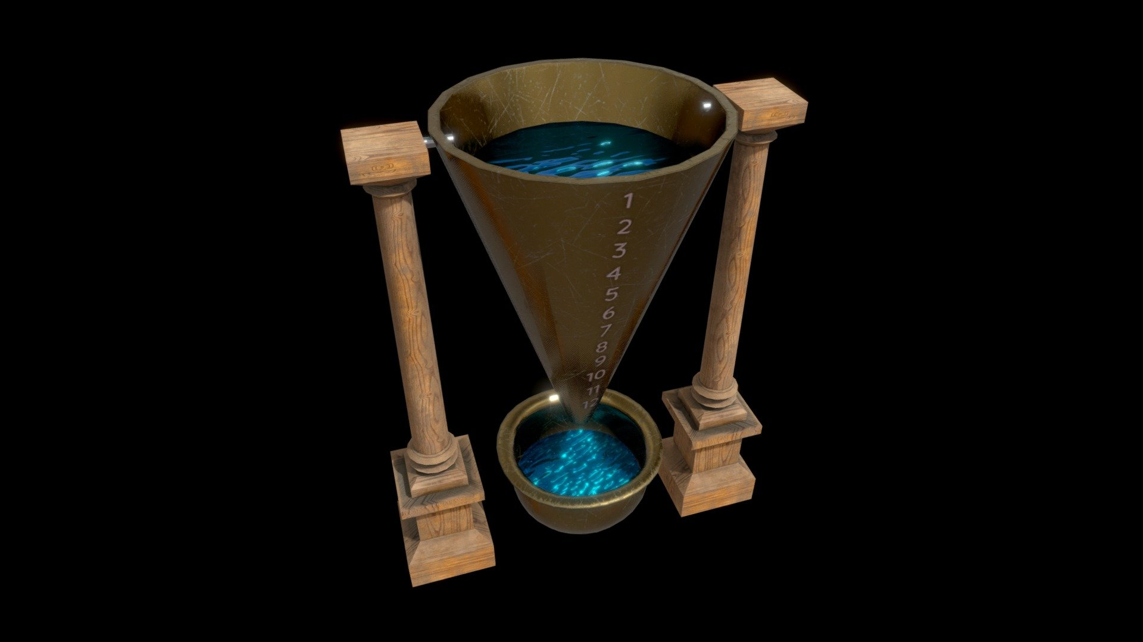
Water clock

Slide 30
In the 13th century, the mechanical clock was introduced, providing greater accuracy but at a high cost. Over the centuries, mechanical clocks evolved, especially with the addition of springs around 1500, which made the clocks smaller and more precise, eventually reaching accuracy levels of one-hundredth of a second per day.

Slide 31
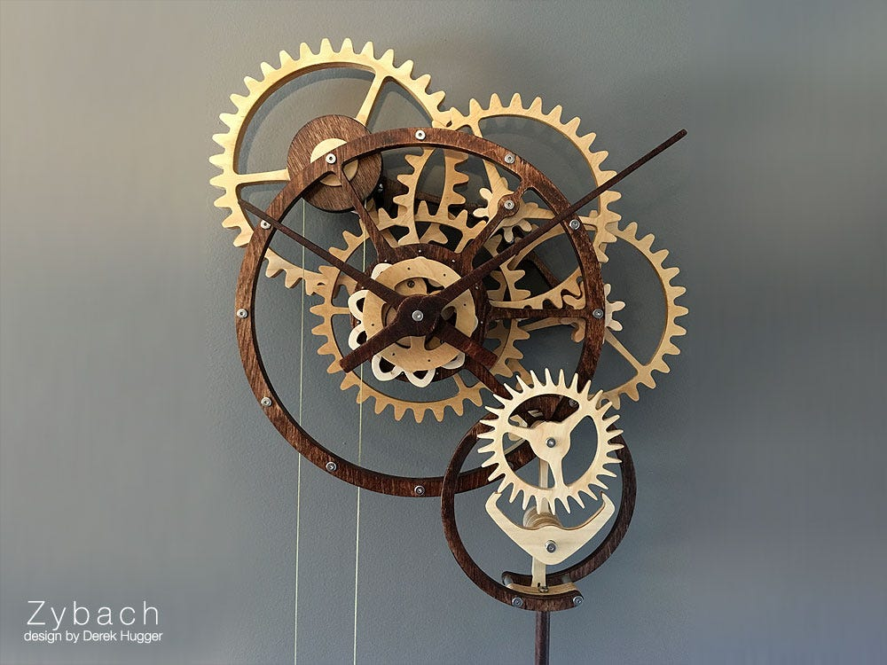
Mechanical clock

Slide 32
In 1927, the quartz clock was developed, which was more accurate due to the regular vibrations of quartz when an electric current passed through it. This made clocks cheaper and more widely used in business, transportation, and markets.

Slide 33
Quartz Clock

Slide 34
By 1956, the digital clock was introduced, and today, satellites provide the exact time to devices like cell phones. Despite all these advancements, many people still struggle with punctuality and keeping appointments.

Slide 35
Digital clock

Slide 36
Reading 2: What Time is it?
Skimming
The passage is about the history of clocks.
Close Reading:
2. Write the answers to these questions.
Why was the sundial an improvement over the sun clock?
The sundial was smaller and more portable than the sun clock and could measure time for half a day.
What was one problem with both the sun clock and sundial?
Both the sun clock and sundial were ineffective on cloudy days or at night.
Where were water clocks used?
Water clocks were used in Egypt, the Middle East, and China.
When did clocks begin to be more accurate?
Clocks began to be more accurate in the 13th century with the invention of the mechanical clock, and later improvements like the addition of springs around 1500 made them more accurate.
What improved the accuracy of the mechanical clock?
The addition of springs around 1500 improved the accuracy of the mechanical clock.
When did people start to rely on clocks to run businesses?
People started to rely on clocks to run businesses after the development of quartz clocks in 1927.

Slide 37
Writing Task
Brainstorming activity:
To have more free time for myself (Goal)
To reduce stress, and To have time for hobbies and relaxation(WHY)
Specific Actions
1. Write down appointments and prioritize them
2. Reduce part-time job hours from 15 to 12 per week
3. Learn to say "no" more often to friends' homework requests
4. Be more organized with time management

Slide 38
Plan
Topic Sentence: I want to have more free time to enjoy my personal interests and reduce stress.
Supporting Details (Three things to achieve this goal):
I will prioritize my tasks by writing down appointments and organizing my schedule.
I plan to reduce my part-time job hours from 15 to 12 hours per week.
I need to learn to say "no" to friends who often ask for help with their homework.
Concluding Sentence: By following these strategies, I will be able to manage my time better and have more time for myself.

Slide 39
WRITE (100-150 words)
I want to have more free time to enjoy my personal interests and reduce stress. To achieve this goal, I will take several steps. First, I will write down my appointments and prioritize my tasks to become more organized and avoid missing important deadlines. Second, I plan to reduce my part-time job hours from 15 to 12 hours per week so I can spend more time relaxing and doing things I enjoy. Finally, I need to learn to say "no" to my friends who often rely on me for homework help. By being more straightforward about my time commitments, I can focus on my own priorities. These strategies will help me balance my responsibilities, manage my time better, and have more free time for myself.

Slide 40
Thanks for attendance

