Slide 1
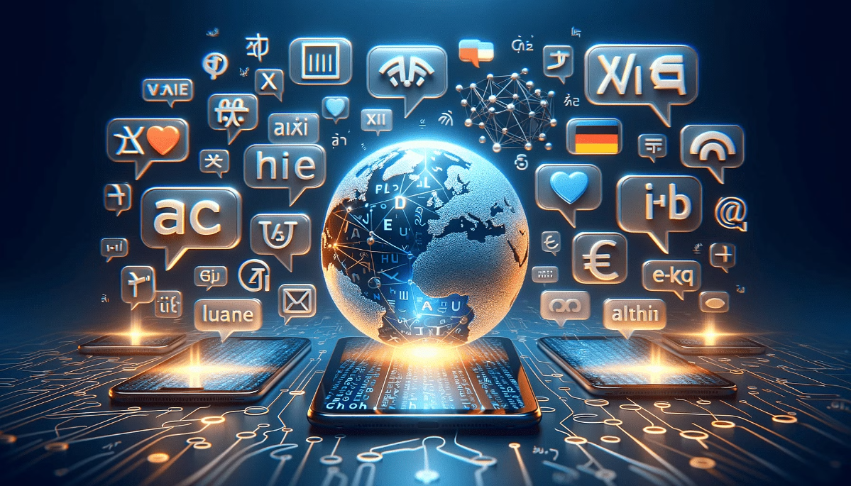
جامعة ديالى كلية التربية للعلوم الإنسانية فسم اللغة الإنكليزية ا.م احمد عادل نوري المرحلة الرابعة / الدراسة الصباحية مادة: الترجمة

Slide 2
Artificial Intelligence and Translation

Slide 3
What is AI Translation?
The language barrier is no longer the hurdle that it once was. In fact, AI translations are making it easier than ever before for people to connect and communicate across the globe. AI translation also has many business applications, making everyday communications with international teams incredibly simple.
The relationship between AI and language learning is also becoming more pronounced. In the past, anyone looking to master a new language would have to invest considerable time and money into group classes or one-on-one tutoring sessions. Although conventional education is still important for anyone looking to achieve full fluency, language learning is becoming far easier thanks to AI and language translation machines.

Slide 4
What is AI Translation? A comprehensive overview
In recent years, AI translation has revolutionized the way businesses and individuals bridge linguistic barriers. But what is AI translation, and how does it differ from traditional translation methods? At its core, AI translation refers to the use of artificial intelligence technologies, such as neural networks and machine learning algorithms, to translate text or speech from one language to another.
Unlike older, rule-based systems, AI translation employs advanced models like Neural Machine Translation (NMT) to process and analyze entire sentences rather than individual words or phrases. This context-aware approach allows AI to deliver translations that are more accurate, fluent, and natural.
A key feature of AI translation is its ability to learn and improve over time. By analyzing vast datasets of multilingual content, AI systems refine their understanding of linguistic patterns, enabling continuous improvement in translation quality. This makes AI translation especially valuable for industries like eCommerce, healthcare, and customer support, where accurate and contextually relevant translations are critical.

Slide 5
The Limits of AI and Translation
At the moment, AI translations are a great option for those who need to translate huge volumes of content quickly. However, even the best language translation machines only go so far when it comes to capturing context. In fact, the most advanced translation technology still struggles when it comes to understanding the nuances of language and emotive aspects.
Ultimately, AI-powered translations can't be depended on to produce compelling content for marketing and advertising purposes. While the bare bones of a text can be translated, a human translator will need to step in to ensure the final text is captivating and persuasive.

Slide 6
Will AI Language Translation Machines
Ever Replace Human Translators?
Even as AI advances, it's unlikely to replace conventional language learning and human translators entirely. Regardless of how much translation technology evolves, languages themselves are what's important. They rely on specific grammar rules and nuanced structures. Ultimately, even the most accessible language families are fairly abstract. The human factor is always going to play a significant role in language learning.
The same logic applies to the translation sector. AI-powered translations are increasingly reliable, but there's still a margin for error that necessities the input of human translators. At a bare minimum, proofreaders are required to review any machine translations. Depending on the end user, extensive editing may be called for. AI language translation may lighten the load for human translators, but it's merely changing the way translators work, rather than pushing them out of a job.

Slide 7
Advantages of AI-Powered Translation
Speed
Reliability
AI translates vast amounts of text in seconds, far outperforming human translators.
Maintains unchanging terminology and style across large documents.
Cost-Effective
Accessibility
Reduces translation costs for businesses and individuals.
Makes translation available to a wider audience through mobile apps.

Slide 8
Are AI Translations Completely Reliable?
Nobody can argue against how increasingly reliable AI translations are becoming. However, we're not yet at a point where AI translations can wholly replace human translators.
With a typical language translation machine, accuracy is incredibly high. However, if something's not 100% perfect, it can't be relied upon for high-stakes communications.
In the international business sector, there's no room for misunderstandings. What's more, diplomatic channels need to have a clear grasp of the nuances of foreign languages to maintain successful correspondence.
In many cases, AI language learning software can be used to provide a reliable first draft of translations. However, face-to-face exchanges and critical communications still need to be managed and overseen by human translators and expert linguists.

Slide 9
Challenges in AI Translation
Idiomatic Expressions
1
AI struggles with culture-specific phrases.
Context Sensitivity
2
Misinterpretation of context can lead to errors.
Specialized Terminology
3
Technical jargon poses challenges for AI systems.
Emotional Tone
4
Capturing tone and emotion remains difficult.

Slide 10
The Future of AI Translation
Real-Time Speech Translation
Multimodal Translation
Cultural Adaptation
AI will translate between text, speech, and sign language effortlessly.
Advanced AI will consider cultural context, improving translation quality.
All-in-one conversations across languages through AI-powered earbuds.

