Slide 1
جامعة ديالى
كلية التربية للعلوم الانسانية
قسم اللغة الانكليزية
مادة الشعر / المرحلة الثالثة
م.م. اليمامة قيس يوسف

Slide 2
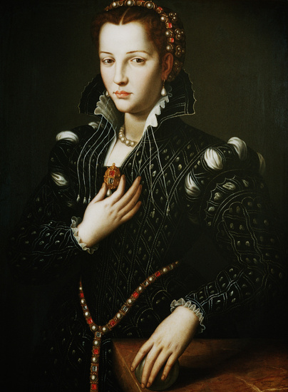
‘MY LAST DUCHESS’ BY ROBERT BROWNING
Notes:
@SPryke2

Slide 3
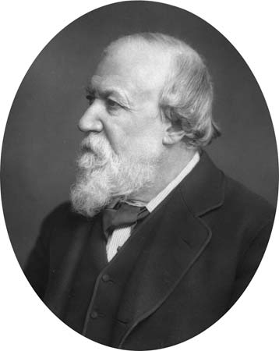
ROBERT BROWNING:
Robert Browning (1812-1889) was heavily influenced as a youngster by his father's extensive collection of books and art. His father was a bank clerk and collected thousands of books, some of which were hundreds of years old and written in languages such as Greek and Hebrew. By the time he was five, it was said that Browning could already read and write well. He was a big fan of the poet Shelley and asked for all of Shelley's works for his thirteenth birthday.
Browning is best known for his use of the dramatic monologue. My Last Duchess is an example of this and it also reflects Browning's love of history and European culture as the story is based on the life of an Italian Duke from the sixteenth century.
The narrator of ‘My Last Duchess’ was – in fact - a real historical figure – Alonso the Duke of Ferrera.
The Duchess he is looking at is the first of three wives who died after two years of marriage under suspicious circumstances. Her name was Lucrezua de’Medici.

Slide 4
MY LAST DUCHESS
That’s my last Duchess painted on the wall,
Looking as if she were alive. I call
That piece a wonder, now; Fra Pandolf’s hands
Worked busily a day, and there she stands.
Will’t please you sit and look at her? I said
“Fra Pandolf” by design, for never read
Strangers like you that pictured countenance,
The depth and passion of its earnest glance,
But to myself they turned (since none puts by
The curtain I have drawn for you, but I)
And seemed as they would ask me, if they durst,
How such a glance came there; so, not the first
Are you to turn and ask thus. Sir, ’twas not
Her husband’s presence only, called that spot
Of joy into the Duchess’ cheek; perhaps
Fra Pandolf chanced to say, “Her mantle laps
Over my lady’s wrist too much,” or “Paint
Must never hope to reproduce the faint
Half-flush that dies along her throat.”
Such stuff
Was courtesy, she thought, and cause enough
For calling up that spot of joy. She had
A heart—how shall I say?— too soon made glad,
Too easily impressed; she liked whate’er
She looked on, and her looks went everywhere.
Sir, ’twas all one! My favour at her breast,
The dropping of the daylight in the West,
The bough of cherries some officious fool
Broke in the orchard for her, the white mule
She rode with round the terrace—all and each
Would draw from her alike the approving speech,
Or blush, at least. She thanked men—good! but thanked
Somehow—I know not how—as if she ranked
My gift of a nine-hundred-years-old name
With anybody’s gift. Who’d stoop to blame
This sort of trifling? Even had you skill

Slide 5
MY LAST DUCHESS
In speech—which I have not—to make your will
Quite clear to such an one, and say, “Just this
Or that in you disgusts me; here you miss,
Or there exceed the mark”—and if she let
Herself be lessoned so, nor plainly set
Her wits to yours, forsooth, and made excuse—
E’en then would be some stooping; and I choose
Never to stoop. Oh, sir, she smiled, no doubt,
Whene’er I passed her; but who passed without
Much the same smile? This grew; I gave commands;
Then all smiles stopped together. There she stands
As if alive. Will’t please you rise? We’ll meet
The company below, then. I repeat,
The Count your master’s known munificence
Is ample warrant that no just pretense
Of mine for dowry will be disallowed;
Though his fair daughter’s self, as I avowed
At starting, is my object. Nay, we’ll go
Together down, sir. Notice Neptune, though,
Taming a sea-horse, thought a rarity,
Which Claus of Innsbruck cast in bronze for me!

Slide 6
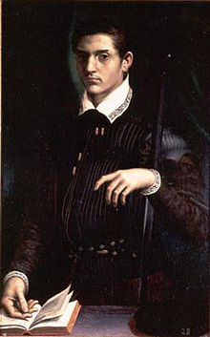
WHAT IS IT ALL ABOUT?
The characters mentioned in this poem are based on real life, historical figures. The narrator is Duke Alfonso II who ruled a place in northern Italy called Ferrara between 1559 and 1597. The Duchess of whom he speaks was his first wife, Lucrezia de' Medici who died in 1561 aged 17, only two years after he married her. In real life, Lucrezia died in suspicious circumstances and might have been poisoned.
The poem is set in 1564, three years after the death of the Duchess. An emissary (messenger or representative) has been sent to see the Duke from the Count of Tyrol. The Count is the father of the Duke's next wife (he married three times in all). The Duke shows the emissary a picture of his late wife and remarks on her character, suggesting that she was unfaithful to him - and hinting that he might have killed her because of it.
During his speech, the Duke makes himself look arrogant, insensitive and selfish. The poem is a dramatic monologue.

Slide 7
The poem is a reflection of life in the Victorian poetry:
Browning, of the Victorian age, wrote real-life poetry that reflected upon some of the darkest aspects of Victorian life. One of those aspects, of course, is the treatment of wives by their husbands. Everyone is familiar with Henry the VIII and his many wives whom he accused and executed . Robert Browning reveals that this mentality was widespread during this time. Wives were viewed as disposable, and their husbands would often accuse them to do away with them when they desired to marry someone else. The life of a Victorian wife was a perilous one.

