Slide 1
The Direct Method
Asst. Prof. Dr. Ghazwan Adnan Mohammed
University of DiyalaCollege of Education for Humanities
Department of English

Slide 2
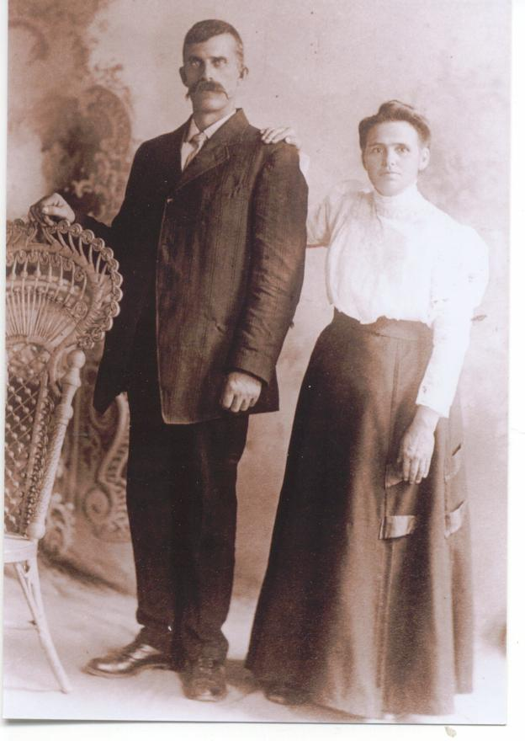
1- He was a teacher of Latin who lived in France in the nineteenth century.
2- A year or two before 1880, Francois decided he needed to learn German.
3- Francois decided that the best way to learn German would be to memorize a German grammar book and the 248 irregular German verbs.
4- He isolated himself in his room for ten days, and successfully memorized the book and the verbs.
5- So, he hurried to the university and went from one class to the next. Gouin recounts his experience:
Francois Gouin

Slide 3
“But alas! In vain did I stain my ears; in vain my eye strove to interpret the slightest movements of the lips of the professor; in vain I passed from the first classroom to a second; not a word, not a single word would penetrate to my understanding. Nay more than this, I did not even distinguish a single one of the grammatical forms so newly studied; I did not recognize even a single one of the irregular verbs just freshly learnt, though they certainly must have fallen in crowds from the lips of the speaker.”

Slide 4
1- He learned as Greek teaching by tackling the Greek roots, he decided to memorize (800) eight hundred German roots–and of course to rememorise the grammar book and irregular verbs.
2- He was convinced that this go-around would surely offer him “the foundations of the language, as well as the laws and secret of its forms, regular and irregular.” After eight days he hurried again to the university. “But alas!” He understood not one word.
3- He tried what should have been a successful strategy: he tried talking with the customers in the shop below his room. But they laughed at him, and embarrassed, sensitive Francois decided to return to the solitude of his room.
4- He spent three weeks memorizing a book of dialogues–but alas!
5- Then he spent a full month memorizing the thirty thousand words of a
dictionary but he says“…I understood not a word–not a single word!
6- He tried reading again. He memorized the dictionary again and later a third time. All to no avail.

Slide 5
Finally, his year-long stay came to an end, and Francois left Germany without ever having learned to speak or understand German. He had, in no uncertain terms, completely and utterly failed in his effort.
Upon his return home Francois found that his little three-year-old nephew had gone through that wonderful, miraculous stage of first-language acquisition in which children, in the course of sometimes less than a year, move from two-year-old “telegraphese” to nonstop chatterboxes of language. Francois perceived that his nephew possessed a secret of some sort and set out to study child language acquisition. His studies revealed many insights about child language acquisition, from which Francois concluded that he and all other language teachers were teaching the wrong way. He invented a method called the Series Method, a direct, conversational approach with no grammatical analysis, no vocabulary memorization, and no translation.

