Slide 1
THE GRAMMAR TRANSLATION METHOD : Part 1
Prof. Dr. Ghazwan Adnan Muhammad
University of Diyala/ College of Education for Human Sciences
Department of English Language

Slide 2
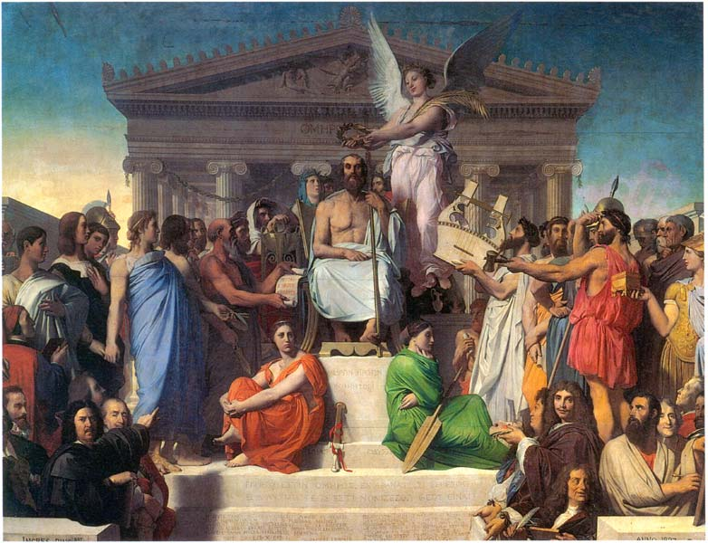
The Grammar Translation Method of Teaching English
The grammar-translation method is a method of teaching foreign languages derived from the classical method of teaching Greek and Latin
Late 19th and early 20th centuries
It was essentially based on the use of L1(mother tongue) and L2(target language)

Slide 3
The method has two main goals:
To enable students to read and translate literature written in the target language
Develop student’s general mental discipline.

Slide 4
Translation is the key to this methodology as is reading and writing. There is not normally any listening or speaking practice carried out moreover, there is virtually no pronunciation practice for the students.

Slide 5
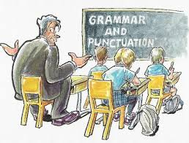
MAJOR CHARACTERISTICS OF GRAMMAR TRANSLATION
1. Classes are taught in the mother tongue, with the
little active use of the target language :
*which means the teacher will teach the target
language using the mother tongue of the
students
*For Malaysian we are going to use Malay
language

Slide 6
MAJOR CHARACTERISTICS OF GRAMMAR TRANSLATION
2. Much vocabulary is taught in the form of lists of
isolated words
*Isolated words is the word that is not connected
to each other
* Vocabulary items are taught in the form of
word list

Slide 7
MAJOR CHARACTERISTICS OF GRAMMAR TRANSLATION
3. Long, elaborate explanations of the intricacies of
grammar are given
* The teacher will explain details about the
grammar rule in the simple grammar table
* for example, in teaching of the Subject Verb
Agreement

Slide 8
MAJOR CHARACTERISTICS OF GRAMMAR TRANSLATION
4. Grammar provides the rules for putting words
together, and instruction often focuses on the form
and inflection of words
*which means the grammar rules provide us
the way to construct sentences in a proper way,
to give instructions to form and says the word
properly

Slide 9
*For example the grammar rule will guide us to
pronounce words using correct pronunciation
- We will pronounce the word read as read
when the action word in the present tense
whereas we will pronounce the word read as
read when the action word is in the past tense

