Slide 1
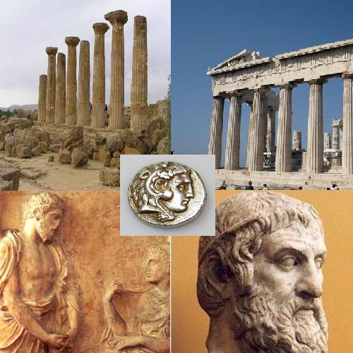
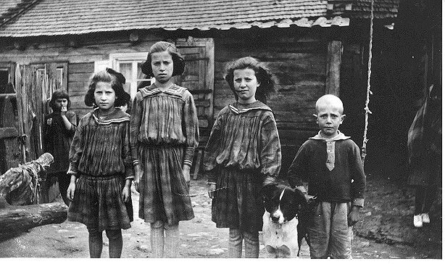
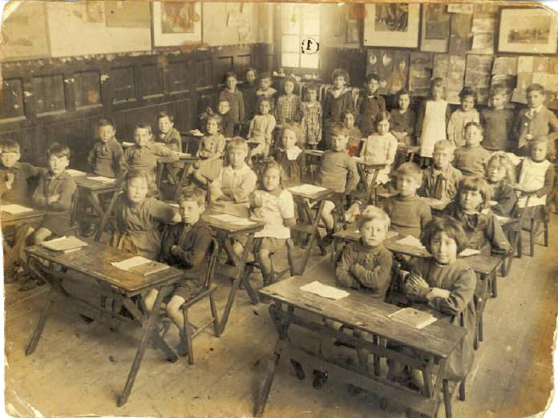
THE GRAMMAR TRANSLATION METHOD : Part 2
Prof. Dr. Ghazwan Adnan Muhammad
University of Diyala/ College of Education for Human Sciences
Department of English Language

Slide 2
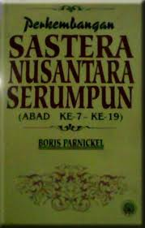
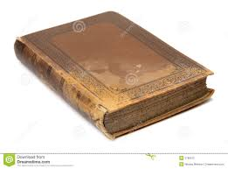
MAJOR CHARACTERISTICS OF GRAMMAR TRANSLATION
5. Reading of difficult classical texts is begun early
*The teacher will expose to students with the
literature text which is classical text earlier
*In Malay, we call it as Kesusasteraan Melayu

Slide 3
MAJOR CHARACTERISTICS OF GRAMMAR TRANSLATION
6. Little attention is paid to the content of texts, which
are treated as exercises in grammatical analysis
*Which means the student will only have to read
the passage and identify the grammar rules
which is related to SVA
*They do not have to understand what is the
passage is all about

Slide 4
MAJOR CHARACTERISTICS OF GRAMMAR TRANSLATION
7. Often the only drills are exercises in translating
disconnected sentences from the target language
into the mother tongue
*This means that the teacher will drill the students
with a lot of exercises that contains sentences in
English and the students must translate the
sentences into their mother tongue

Slide 5
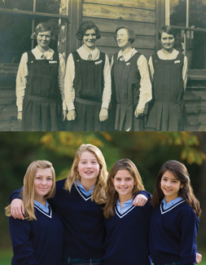
MAJOR CHARACTERISTICS OF GRAMMAR TRANSLATION
8. Little or no attention is given to pronunciation
*The teacher will not emphasize on the way the
students should pronounce the words

Slide 6
MAJOR CHARACTERISTICS OF GRAMMAR TRANSLATION
Teacher
Source of knowledge
Students
Passive

Slide 7
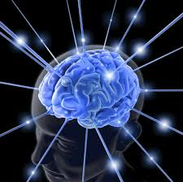
Pros and Cons
Advantages:
Focusing the translation of Vocabularies-beginners
Good for mental exercises.

Slide 8
Disadvantages:
Class time is not allocated for students to produce their own sentences
less time is spent on oral practice (whether productive or reproductive)

Slide 9
Removes any creativity from the class-dull and bored.
Often little contextualization of the grammar
Difficult to describe the actual meaning

Slide 10
TIME FOR ACTIVITies!
Terjemahkan ayat ini ke dalam bahasa ibunda anda.
I am a student
Irsyad is a good boy
Shikin is drinking a cup of coffee
Syira loves her father

Slide 11
CiteD from websites
http://en.wikipedia.org/wiki/Grammar-translation_method
References
Chastain, Kenneth. The Development of Modern Language Skills: Theory to Practice. Philadelphia: Center for Curriculum Development,1971.
Rippa, S. Alexander 1971. Education in a Free Society, 2nd. Edition. New York: David McKay Company, 1971.
Richards, Jack C.; Rodgers, Theodore S. (2001). Approaches and Methods in Language Teaching (2nd ed.). Cambridge, New York: Cambridge University Press.
Rivers, Wilga M. Teaching Foreign Language Skills, 2nd Edition. Chicago: University of Chicago Press, 1981.
http://blog.about-esl.com/grammar-translation-method-teaching-english/
http://www.japantoday.com/category/opinions/view/the-grammar-translation-method-is-it-really-all-that-bad
http://www.nthuleen.com/papers/720report.html

Slide 12
Textbook and video
Prator and Celce-Murcia (1979,p.3) chapter 2 A “Methodical” History of Language Teaching. Teaching by Principles, An Interactive Approach to Language Pedagogy. Third Edition, H. Douglas Brown
http://www.youtube.com/watch?v=bO14GvgOXfM The Grammar Translation Method GTM

Slide 13
THE END ! ☺

